Slide 1


Slide 2
Content
Introduction to Data
Sales & Performance Overview
Customer Analysis
Product Analysis
Recommendations
Conclusion

Slide 3
INTRODUCTION TO DATA
About The Data
Dataset of Brazilian e-commerce orders from Olist, Brazil's largest marketplace department store. Spanning 100,000 orders placed between 2016 and 2018 across various marketplaces, this dataset provides an in-depth view into multiple dimensions of each order, including status, pricing, payment and freight details, customer location, and product features. A supplemental geolocation dataset further enriches this analysis by linking Brazilian zip codes to precise latitude and longitude coordinates.
About Olist
Brazil’s largest department store for online marketplaces, Olist enables small businesses across Brazil to reach a broad audience with ease through a single contract, allowing them to sell via the Olist Store and ship directly to customers using Olist's logistics partners.
Data Source
Publicly available dataset on Kaggle.com

Slide 4
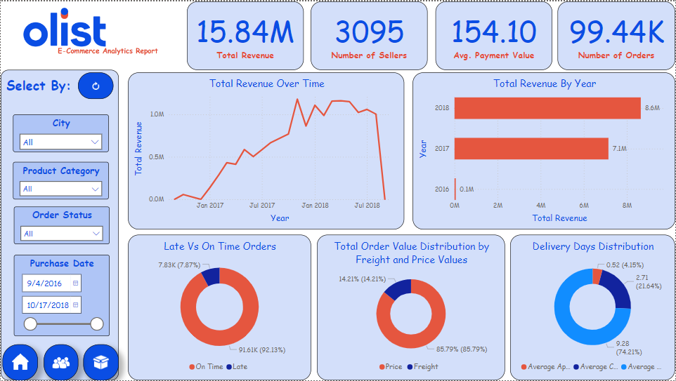
SALES & PERFORMANCE OVERVIEW
This dashboard highlights the sales and performance from 9/4/2016 to 10/17/2019,
- It shows:
  Total revenue of about 15.84M
  3095 available sellers
  Total orders of about 99.44K
- Freight Percentage
Showing what percentage of the total order value paid by customers is freight compared to item price values.

Slide 5
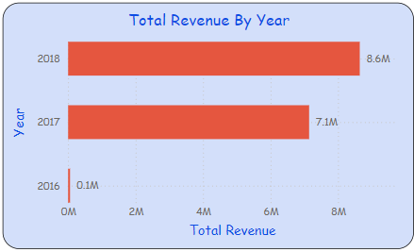
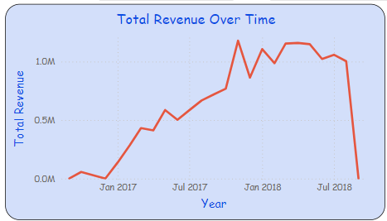

Revenue Growth Rate
Showing Revenue Growth Rate with significant growth from 2017 with 7.1M to 2018 with 8.6M.
With highest achieved value of 2018 in April.

Slide 6
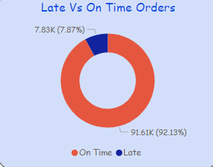
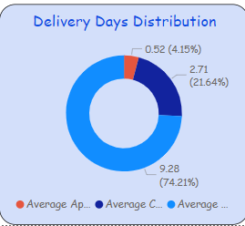
Late Delivery Rate
Shows the percentage of late deliveries from the total delivered orders which is about 7.87%
- Average Delivery Days
Shows how the average delivery days are distributed from the purchase to approval, approval to carrier pickup, until the order is delivered to the customer, with most of which from the carrier pickup to the customer with about 9 days.

Slide 7
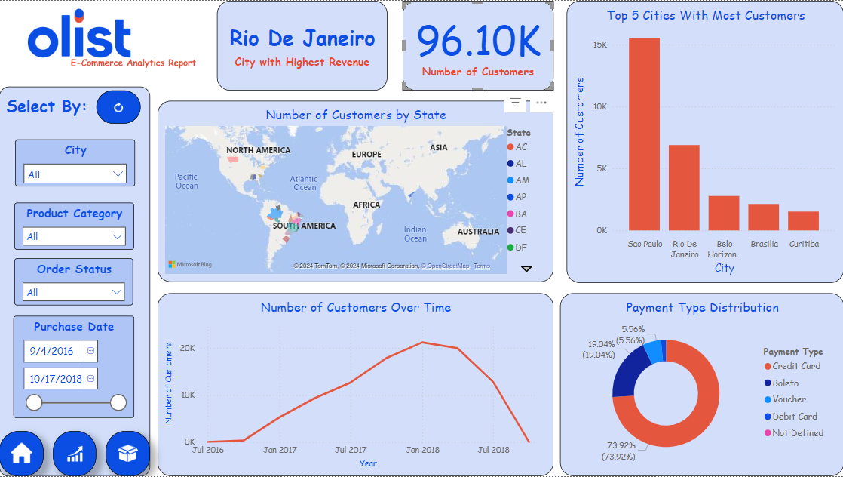
CUSTOMER ANALYSIS
This dashboard highlights the customer analysis and market overview.
It shows:
  Total number of customers of 96.10K
  Customer distribution by the different states

Slide 8
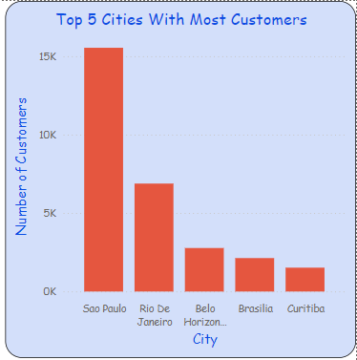


-Top Cities by Revenue and Orders
Top 5 cities with the most customers with Sao Paulo being the highest with 15,540 customers.
While Rio De Janeiro being the highest in terms of revenue.

Slide 9
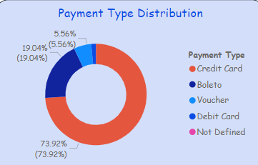
Preferred Payment Types
Shows that Credit Card payment is the most preferred type by customers with 73.92% followed by Boleto 19%, while the least preferred is Debit Card payment with 5.56%.

Slide 10
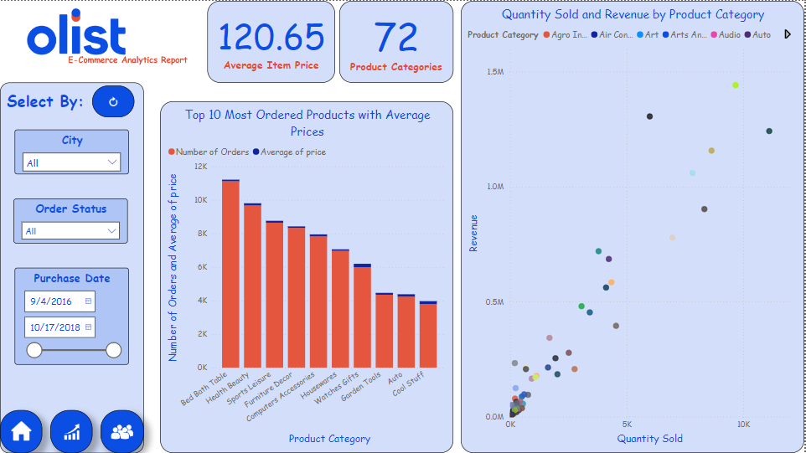
PRODUCT ANALYSIS
Finally, product analysis shows that
  72 available product categories
  With average item price of 120.65

Slide 11
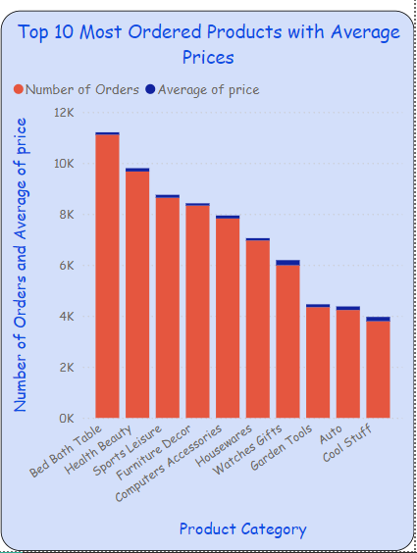
- Most Ordered Products
Top 10 most ordered products and average price of each with highest with the highest being Bed Bath Table products 11,115 orders and average price of 93.30 followed by Health Beauty with 9,670 orders and average price of 130.16

Slide 12
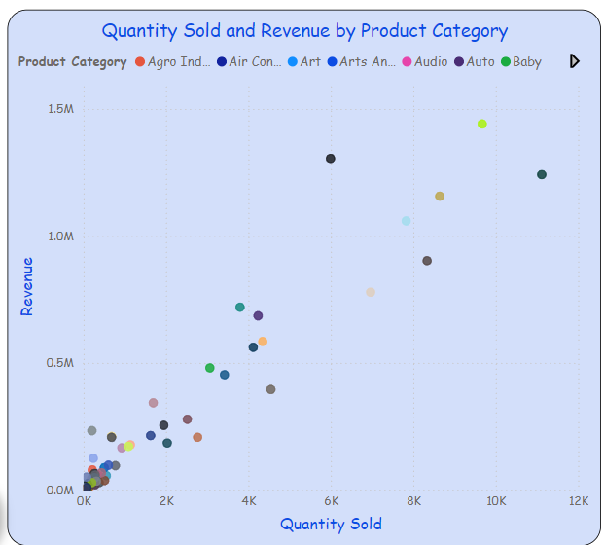
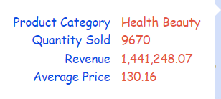

- Product Profitability
Showing the total revenue generated by each product category. It shows that Bed Bath Products are the most ordered, Health Beauty products generated the most revenue due to their average price difference.

Slide 13
RECOMMENDATIONS
Based on report’s insights, here are some recommendations that could help improve Olist’s performance, customer satisfaction, and revenue growth:
  Improve delivery efficiency to reduce average delivery time.
  Manage freight costs by negotiating better rates and incentivizing larger orders.
  Focus on high-demand product categories to increase sales.
  Target high-revenue cities like Rio de Janeiro with tailored marketing.
  Encourage credit card usage through rewards and discounts.
  Develop loyalty programs for customer acquisition and retention.
  Enhance the purchase-to-approval process to streamline customer experience.
  Set revenue growth targets aligned with peak sales periods.

Slide 14
CONCLUSION
In conclusion, this report provides a comprehensive view of Olist's performance across sales, customer demographics, delivery metrics, and product demand.
Key insights reveal opportunities to enhance delivery efficiency, manage freight costs, and optimize inventory for high-demand products. Focusing marketing efforts on top-revenue cities like Rio de Janeiro and incentivizing preferred payment methods can further drive growth.
By implementing these recommendations, Olist can improve customer satisfaction, reduce operational costs, and continue its upward trajectory in Brazil's e-commerce landscape.

